Slide 1

WELCOME

Slide 2

Advanced SQL – Reinforcement Project – IMDB Dataset
Name : Deepti Horakeri
Date : 30/12/2024
Course : Data Science and Data Analytics
Batch : B5 Online

Slide 3
Aim: To analyze and extract valuable insights through careful observation and evaluation.
Dataset Overview:
There are totally six tables in IMDB dataset
Director_mapping
Genre
Movie
Names
Ratings
Role_mapping

Slide 4
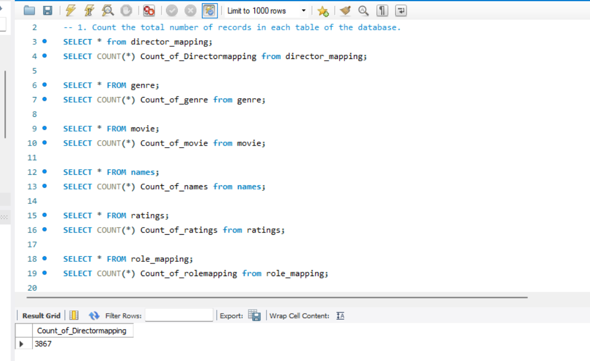
Count the total number of records in each table of the database.

Slide 5
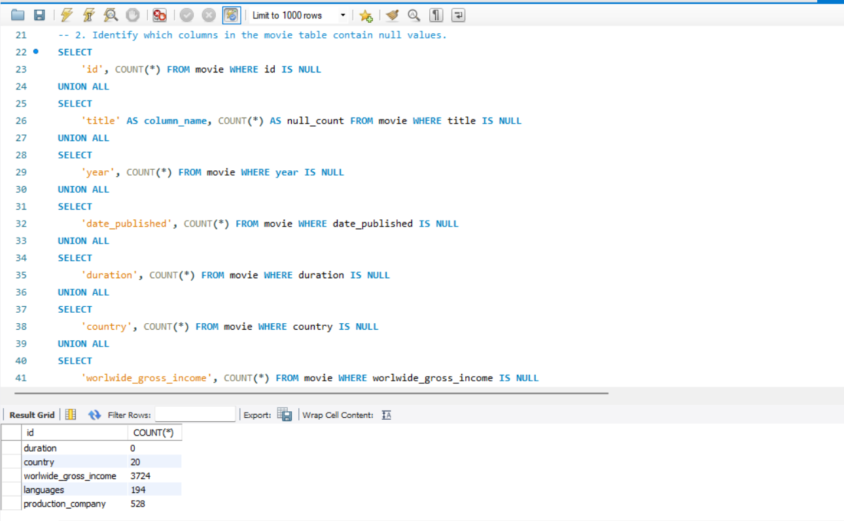
Identify which columns in the movie table contain null values.

Slide 6
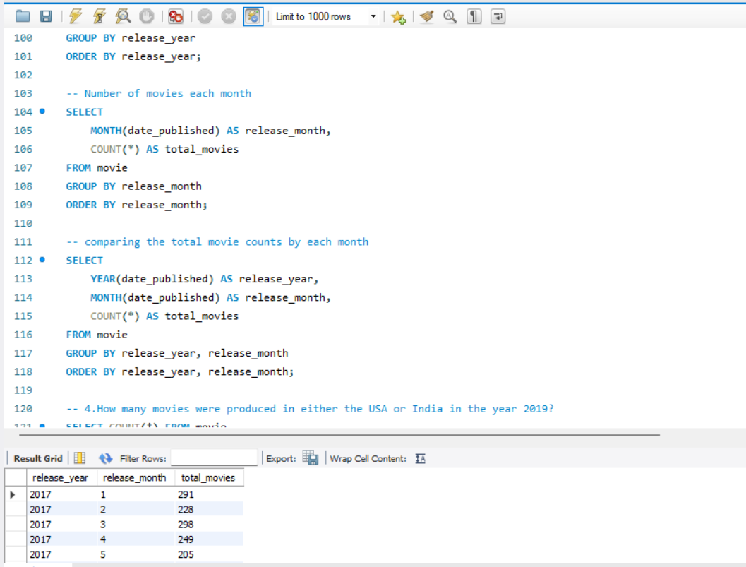
Determine the total number of movies released each year, and analyze how the trend changes month-wise.

Slide 7
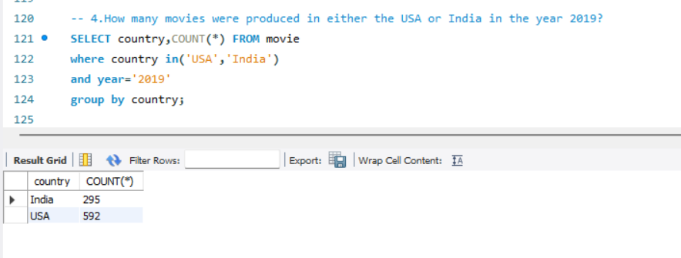
How many movies were produced in either the USA or India in the year 2019.

Slide 8
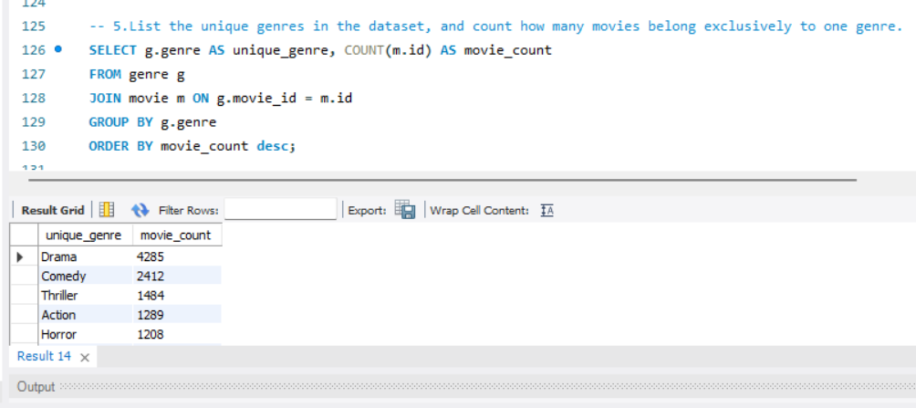
List the unique genres in the dataset, and count how many movies belong exclusively to one genre.

Slide 9
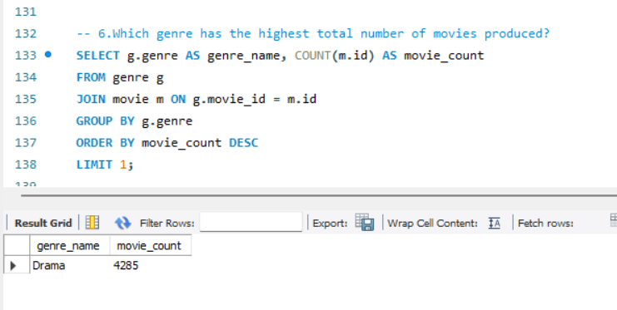
Which genre has the highest total number of movies produced?

Slide 10
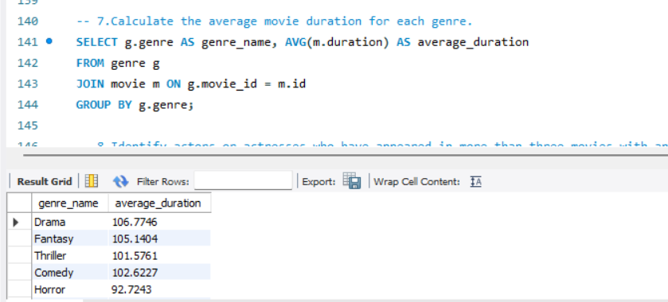
Calculate the average movie duration for each genre.

Slide 11
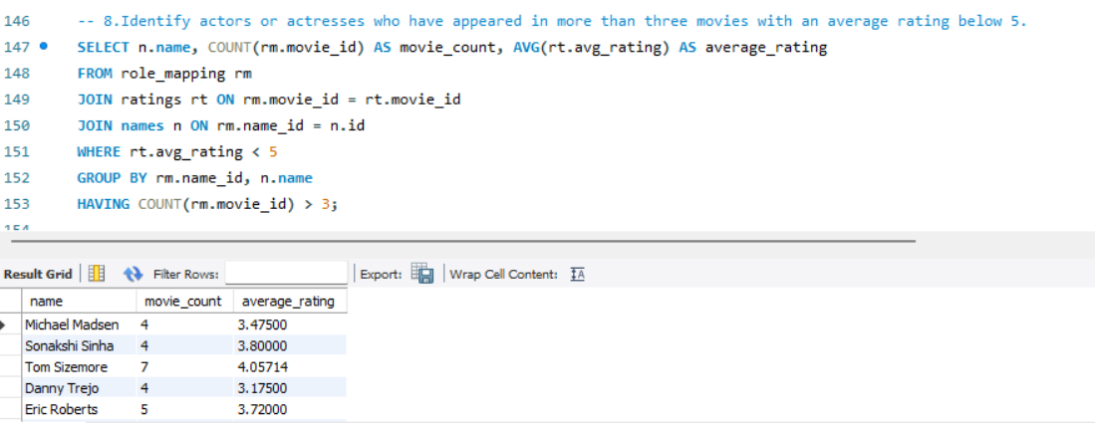
Identify actors or actresses who have appeared in more than three movies with an average rating below 5. Identify actors or actresses who have appeared in more than three movies with an average rating below 5.

Slide 12
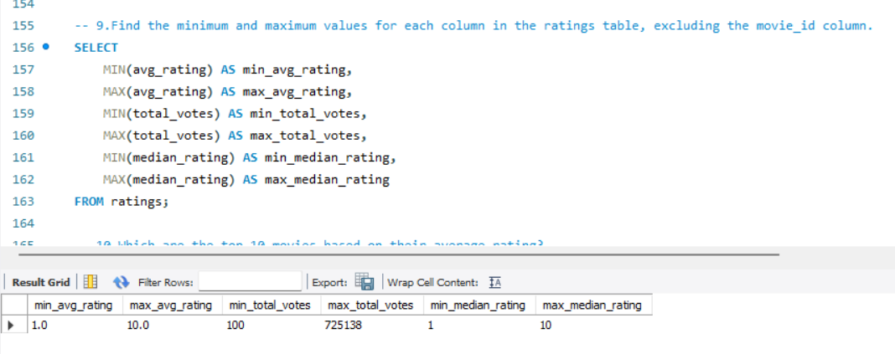
Find the minimum and maximum values for each column in the ratings table, excluding the movie_id column.

Slide 13
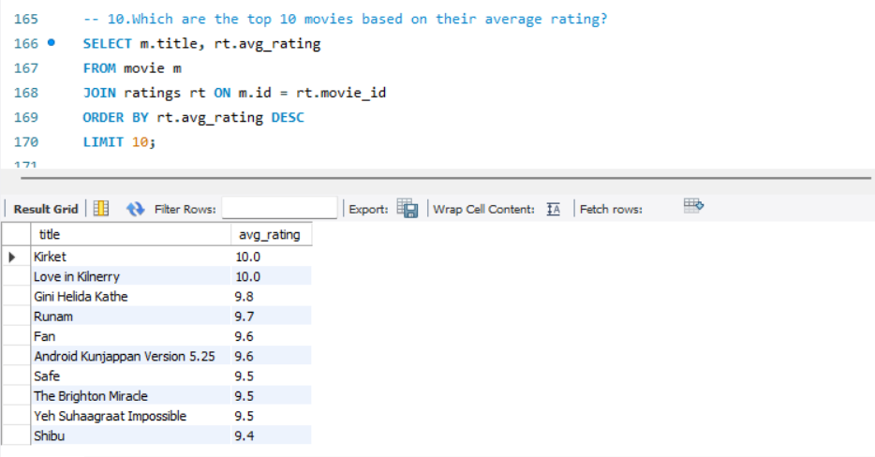
Which are the top 10 movies based on their average rating?

Slide 14
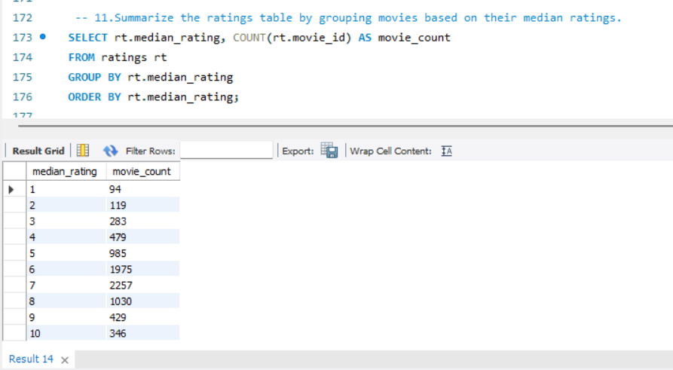
Summarize the ratings table by grouping movies based on their median ratings.

Slide 15
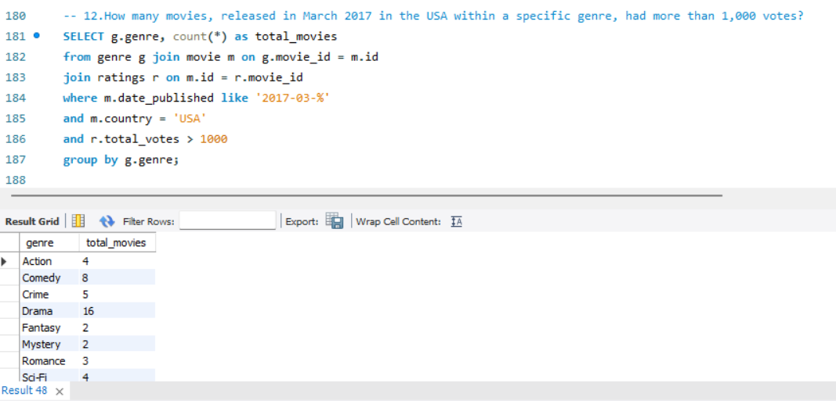
How many movies, released in March 2017 in the USA within a specific genre, had more than 1,000 votes?

Slide 16
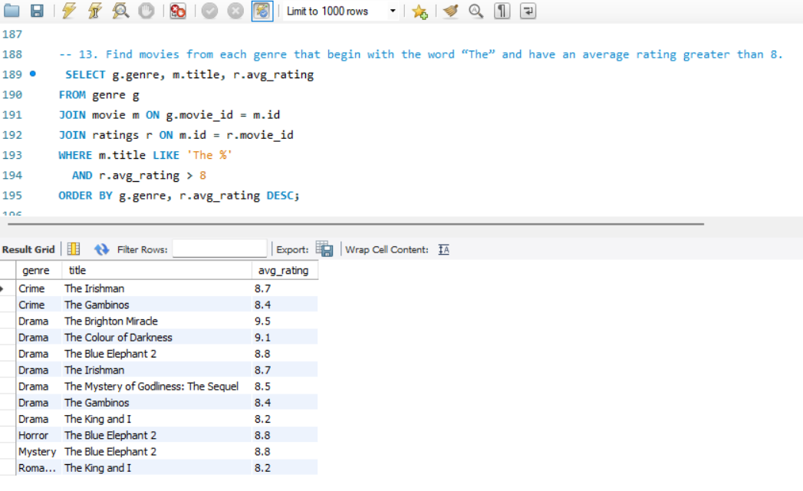
Find movies from each genre that begin with the word “The” and have an average rating greater than 8.

Slide 17
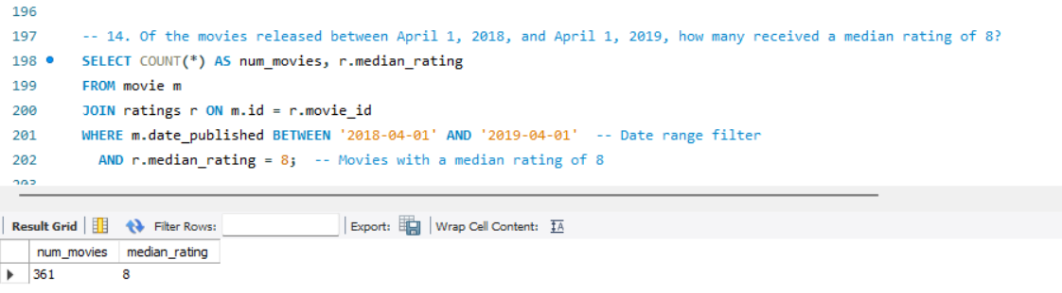
The movies released between April 1, 2018, and April 1, 2019, how many received a median rating of 8?

Slide 18
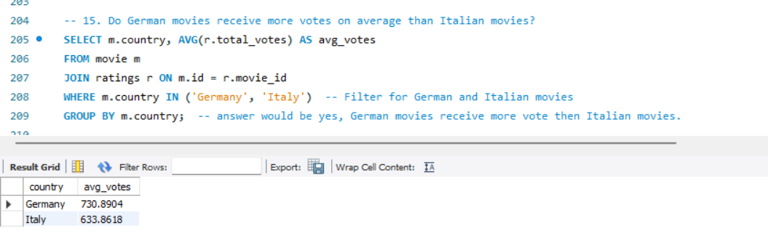
Do German movies receive more votes on average than Italian movies?

Slide 19
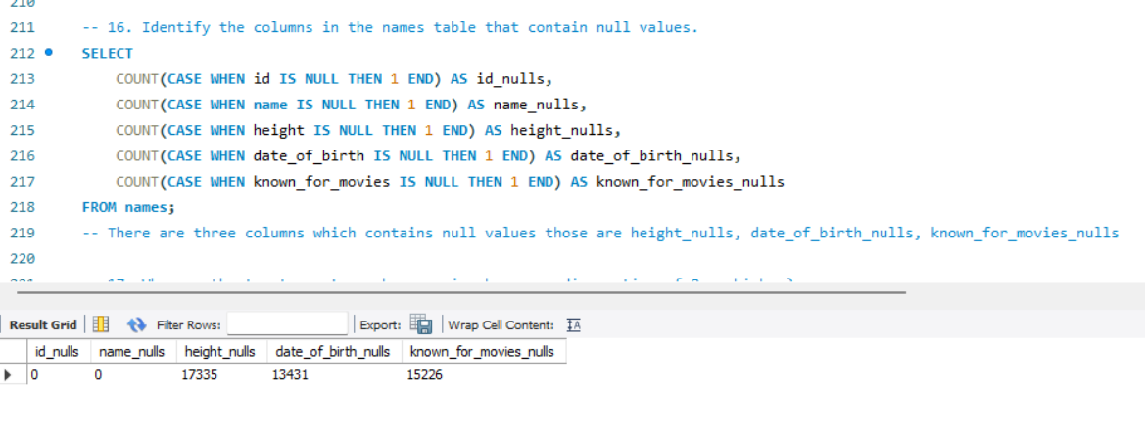
Identify the columns in the names table that contain null values.

Slide 20
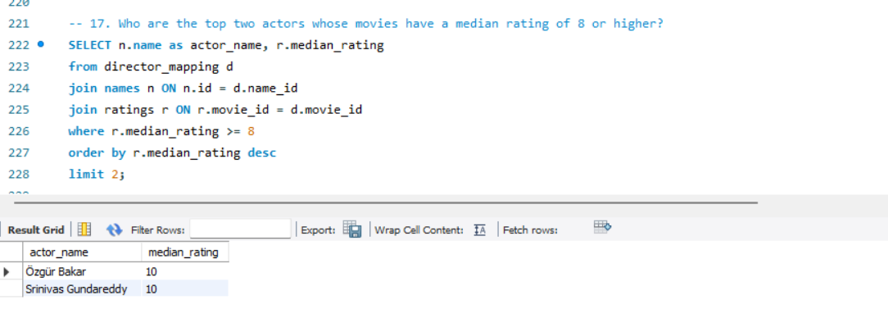
Who are the top two actors whose movies have a median rating of 8 or higher?

Slide 21
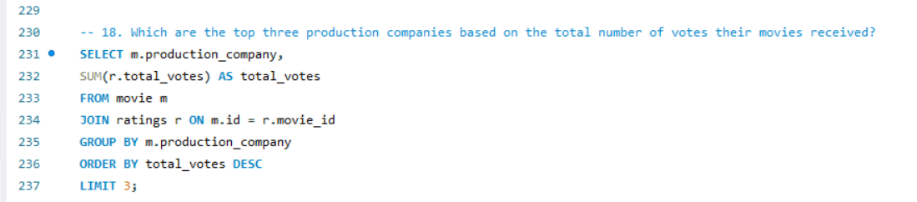
Which are the top three production companies based on the total number of votes their movies received?

Slide 22
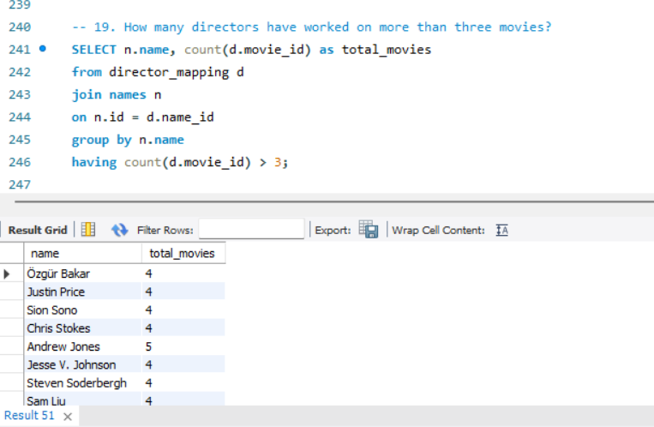
How many directors have worked on more than three movies?

Slide 23
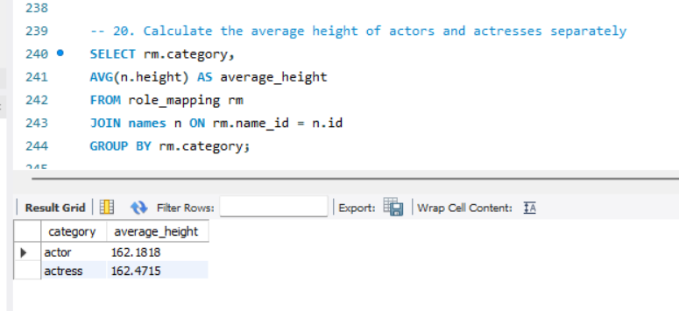
Calculate the average height of actors and actresses separately

Slide 24
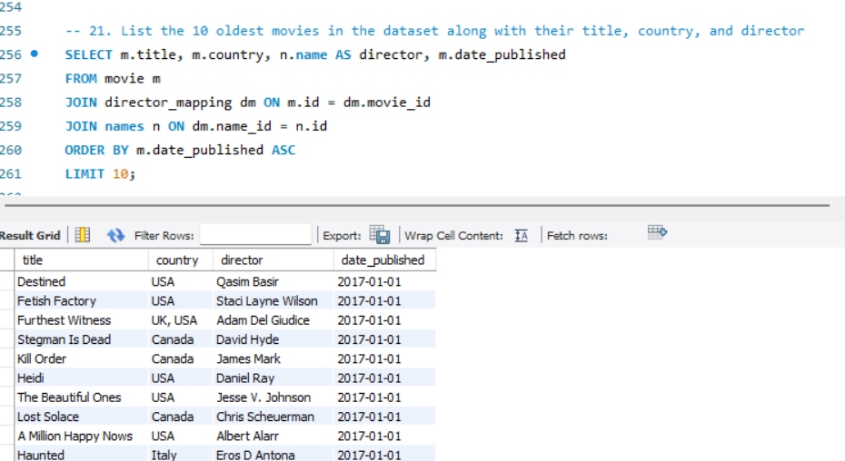
List the 10 oldest movies in the dataset along with their title, country, and director

Slide 25
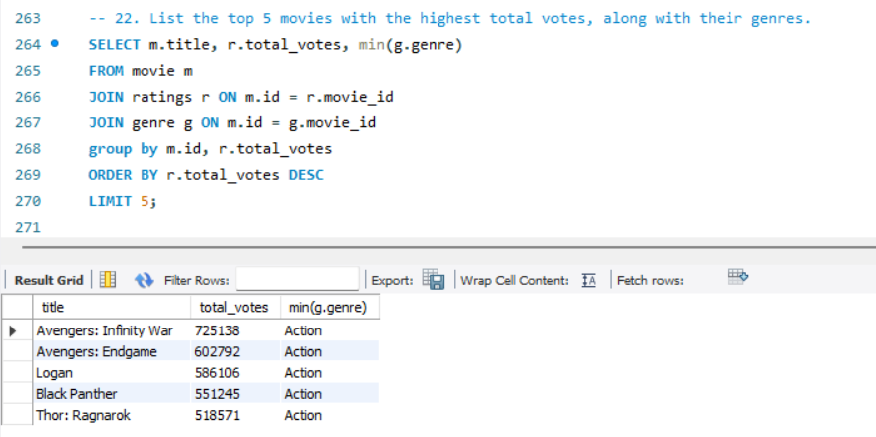
List the top 5 movies with the highest total votes, along with their genres.

Slide 26
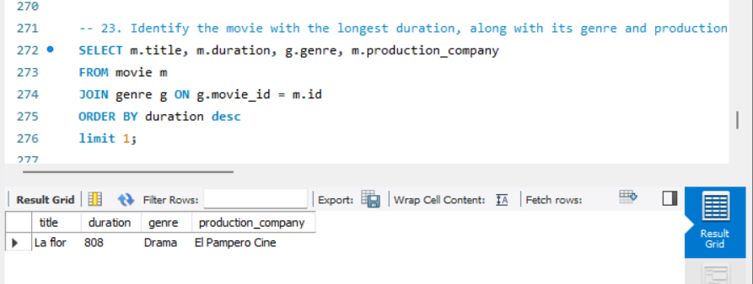
Identify the movie with the longest duration, along with its genre and production company.

Slide 27
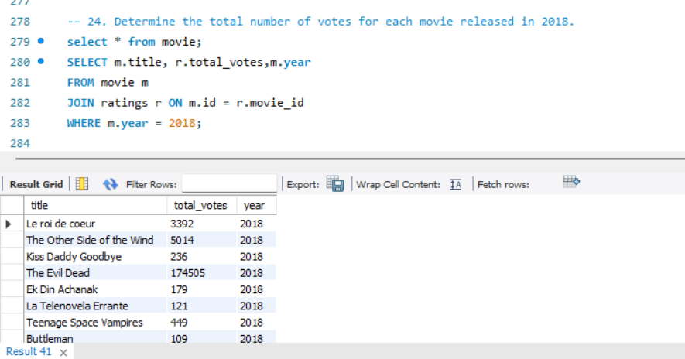
Determine the total number of votes for each movie released in 2018.

Slide 28
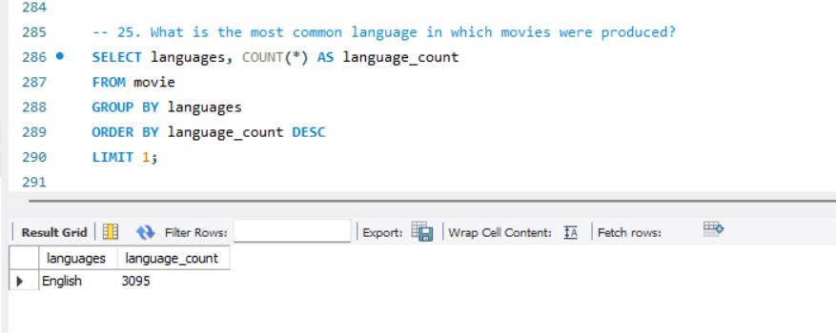
What is the most common language in which movies were produced?

Slide 29
Insights :
The sales trend goes on decreasing as time moves.
In the month of march movies released are the highest.
Drama genera has the highest number of movies.
Most of the action movies are having the highest duration.
USA is highest contributors of movies in dataset then comes India.

Slide 30
THANK YOU...

